Slide 1
Do
Online
than

Slide 2
Group Member Introduction:
M. Zohaib Hassan ( DS-033 ) Nisha Malik ( DS-035) Maryam Waseem (DS-053) Hafsa Mahnoor (DS-038)

Slide 3
Introduction

Slide 4
Introduction:
Research Topic/Hypothesis: Online shopping cause people to spend more money than in-person shopping.
Target Audience: Post graduate students and working professionals aged between 20 to 35.
Approach: To carry out the task we have build a questionnaire of 15 questions in which we collected data regarding Gender, Age, Demographics, Monthly Income and questions related to Online Shopping such as Online shopping store preference, Online shopping monthly expenditure, Customer Satisfaction and Overall experience.

Slide 5
Introduction:
Statistical Test: We performed several statistical test including Proportion testing, Mean testing and Hypothesis testing. We also applied Correlation to identify relations among variables and Regression technique to predict one of the variables from our questionnaire.
Software: All the Statistical analysis is performed using Minitab.

Slide 7
Data Collection:
This survey collected information from the targeted people like age between 21 to 30 above about their opinions, behavior, or knowledge for online shopping.
We have added total 15 questions in our questionnaire, most of questions were qualitative in nature.
Over 100+ responses achieved during the survey.

Slide 8
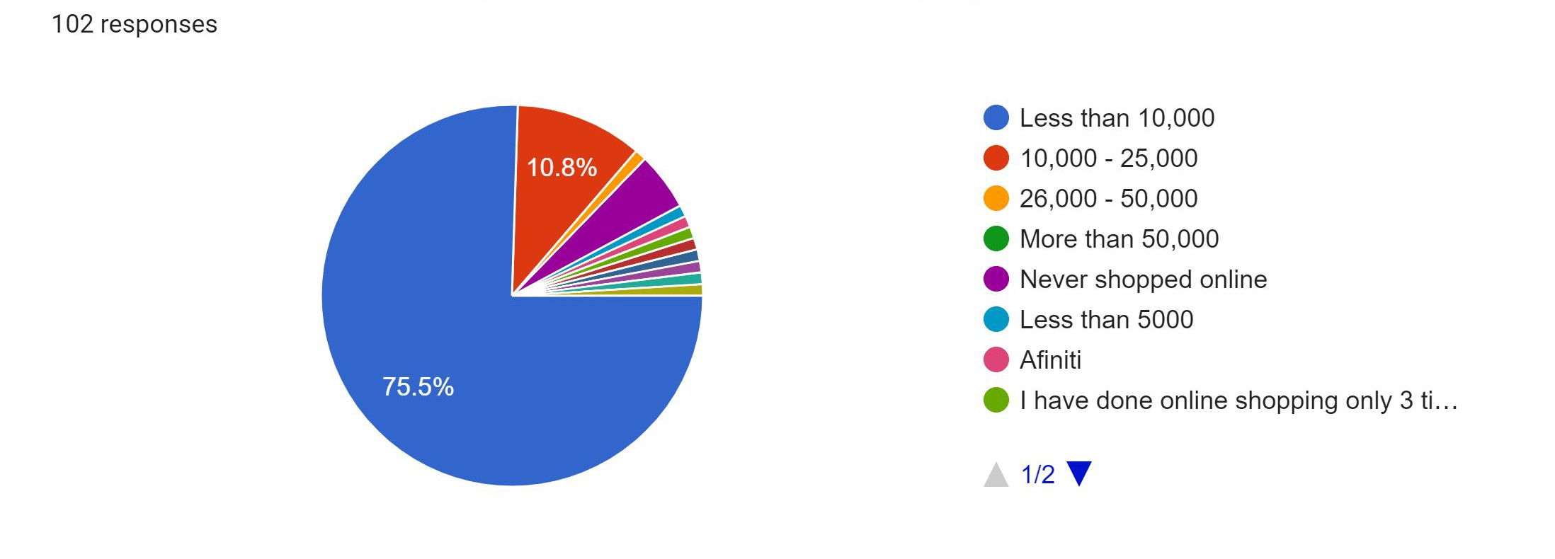
People’s average opinion held by questionnaire:
Consumer Spend money in Online Shop:
Among the 102 samples, Majority of the people - over 75.5% were spend less than 10,000 amount on online shopping in a month and over 20% of the people were spend more than 10,000 amount on online shop in a month.

Slide 9
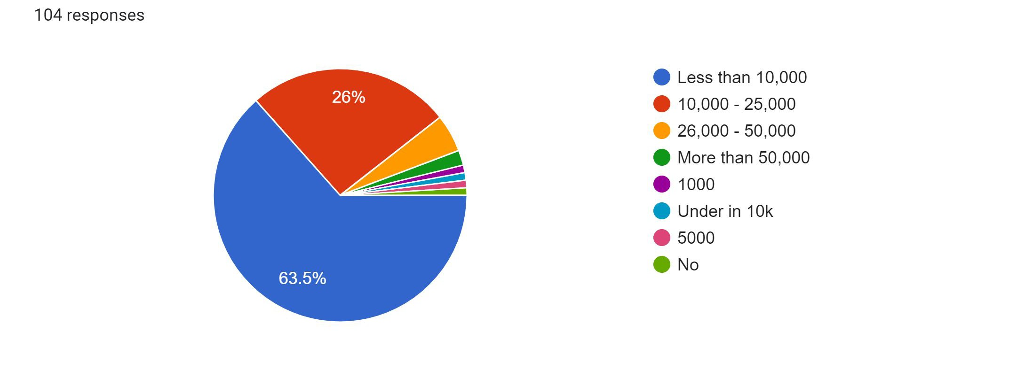
People’s average opinion held by questionnaire:
Consumer Spend money in Visit In-store:
Among the 104 samples, Majority of the people - over 63.5% were spend less than 10,000 amount on physical shopping in a month and over 45% of the people were spend more than 10,000 amount on physical shop in a month.

Slide 11
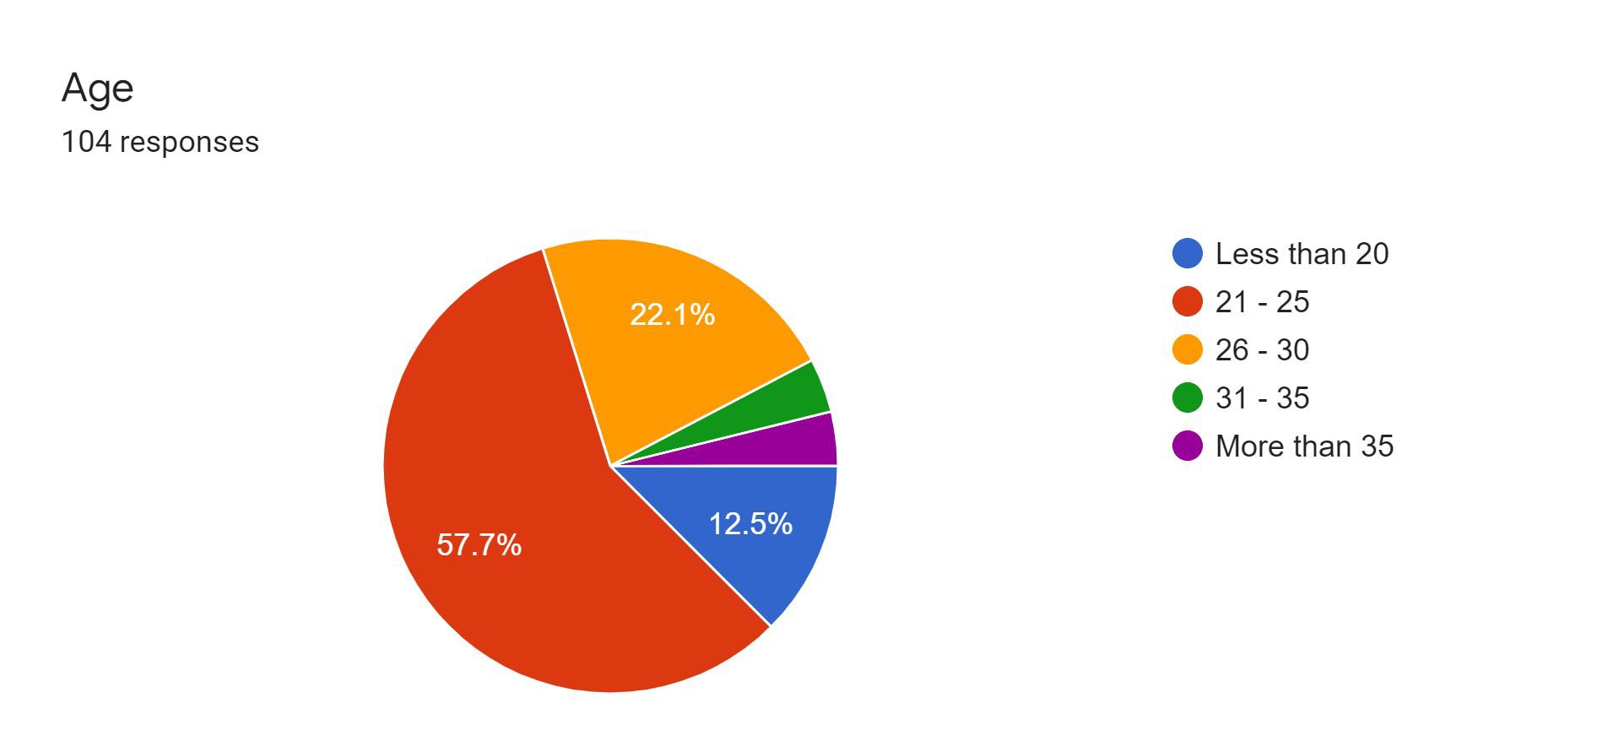
Age Group Respondent:
We had over 104 responses from different age groups. Majority of our respondents were below 25 years.During survey it was found that majority of the people - over 57.7% belong to 21- 25 years and 31% of the people were in 26 to 40 years age group. We believe this suggests that the young generation are more incline to online shopping.

Slide 12
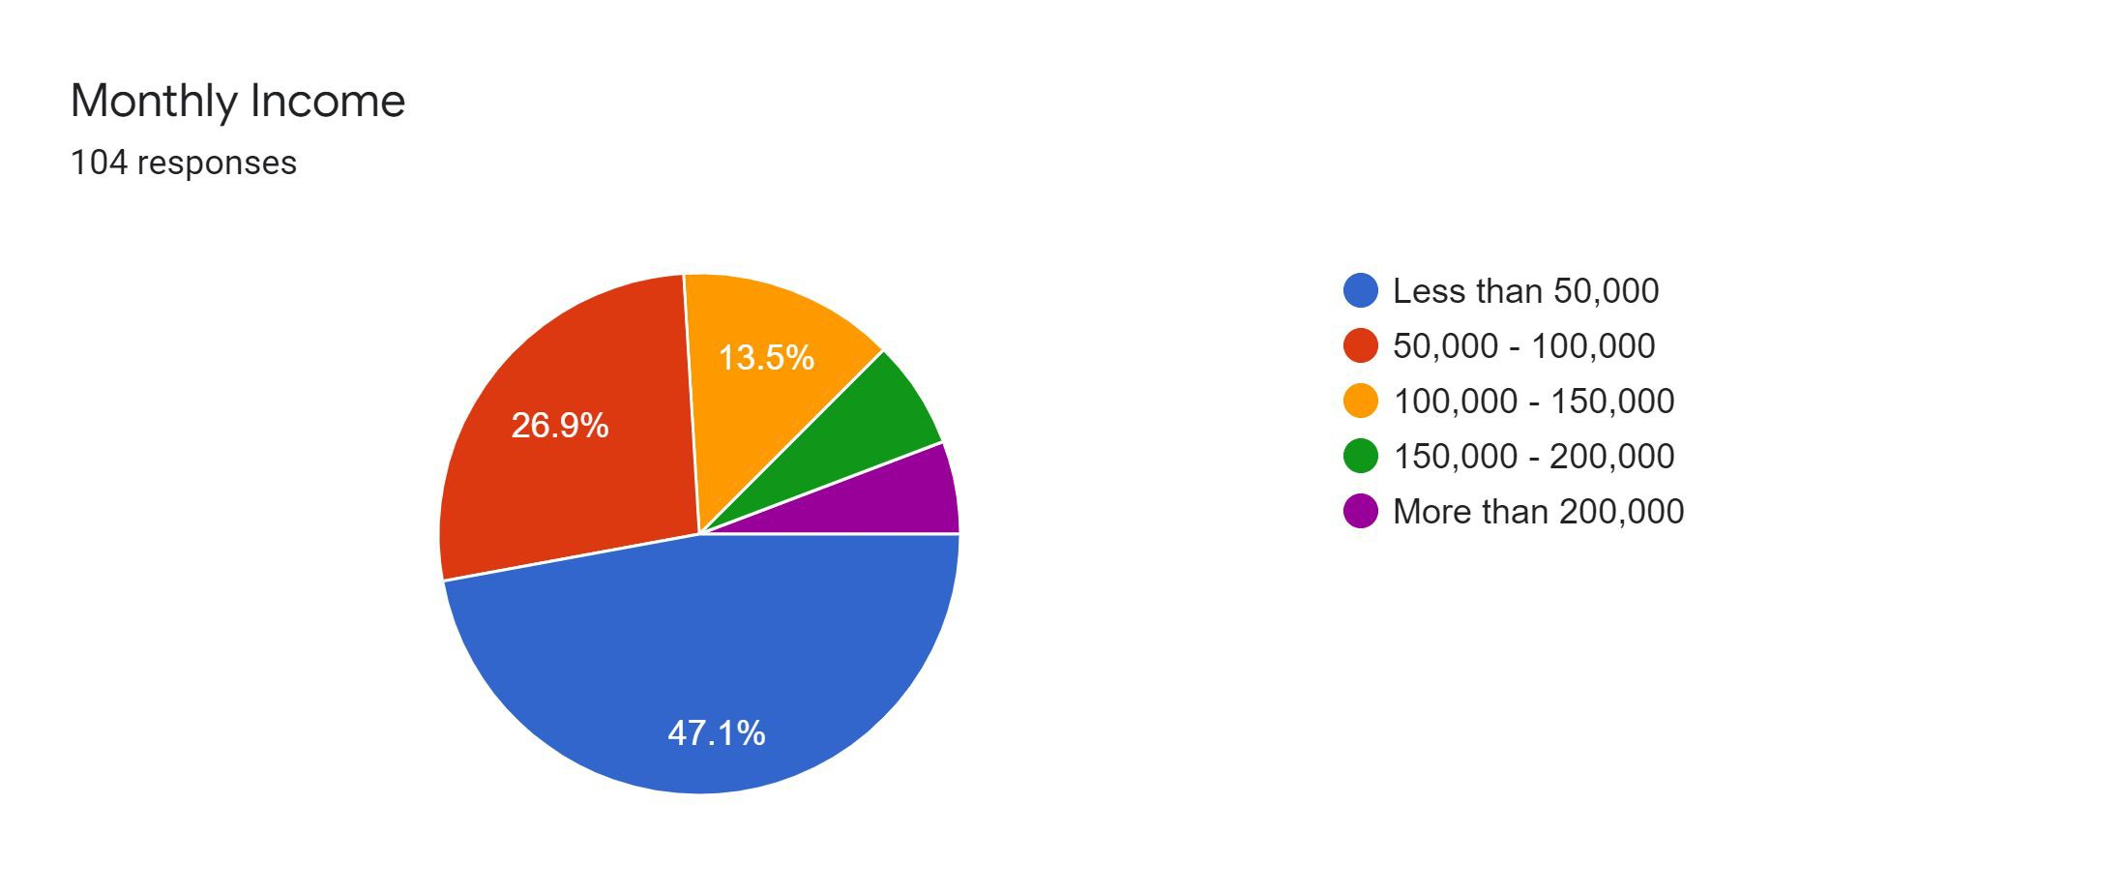
Monthly Income Respondent:
Among the 104 samples, the respondents included both males and females. Majority of the people - over 53% were belong to more than 50,000 monthly income and over 47% of the people were belong to less than 50,000 monthly income.

Slide 13
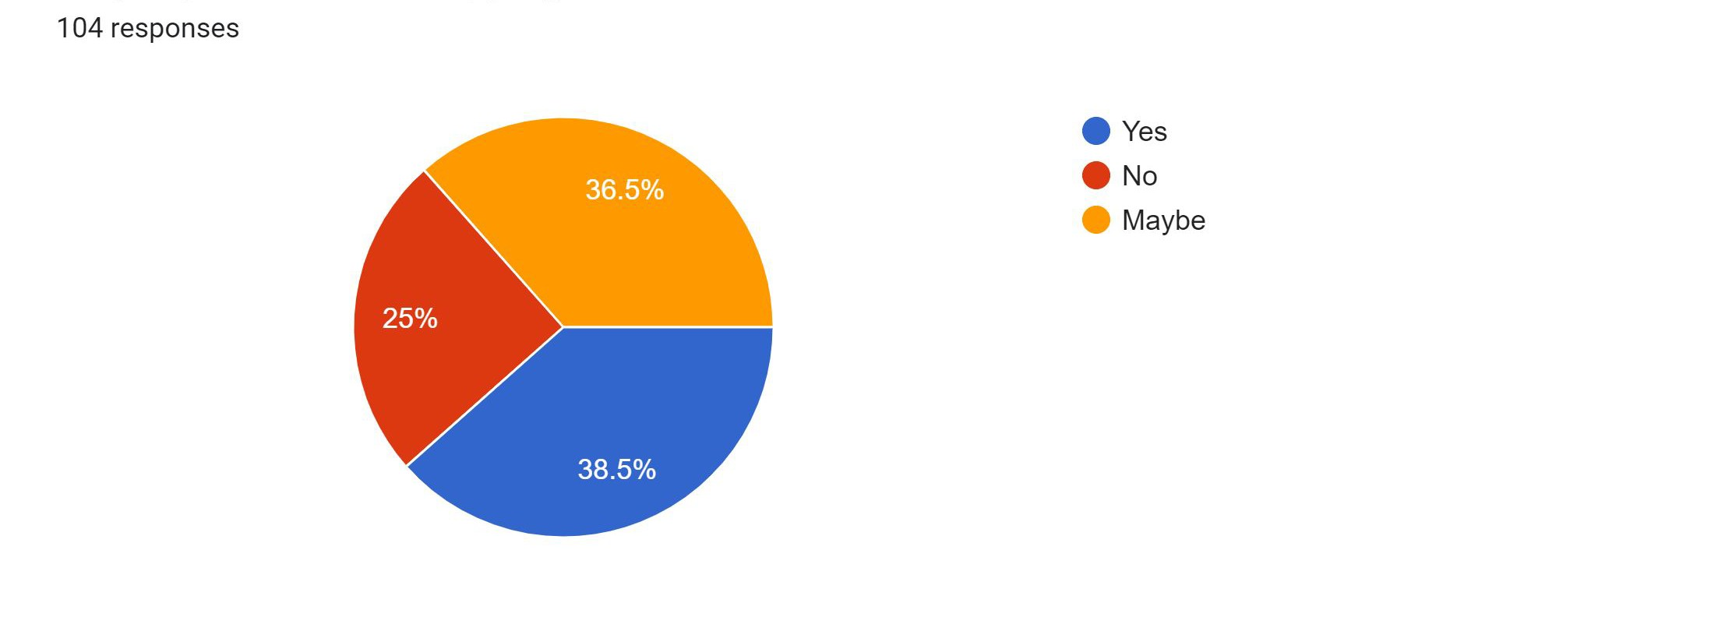
Prefer online shopping:
Over 70% of respondents shared that their shopping activity is done online and over 30% surveyed people admitted they did not preferred shop online.This result was surprising to us and showed how a large population of youngsters are comfortable with online shopping.

Slide 14
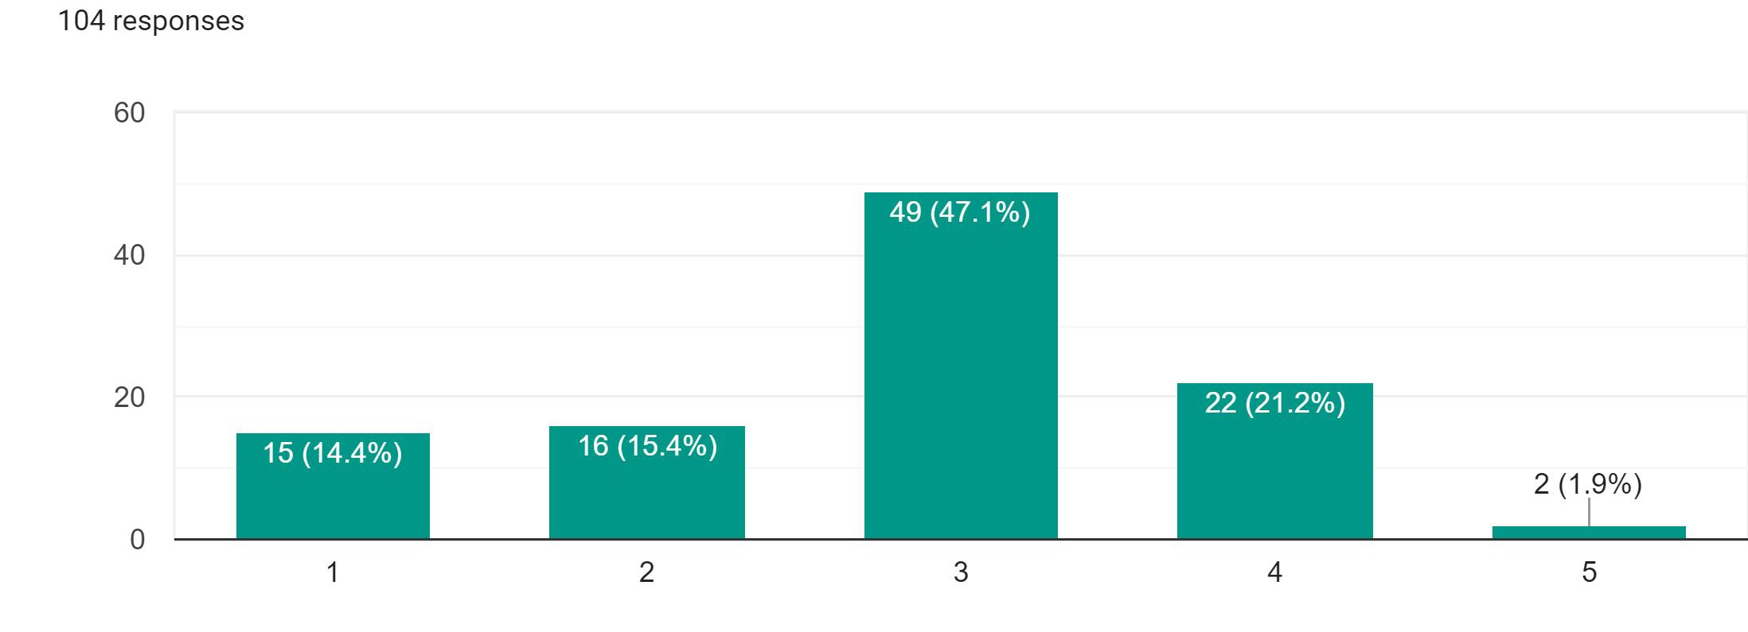
Trust on Online Shop:
We had 104 responses, It was found over 49 respondent trust 47.1% in online shopping.

Slide 15
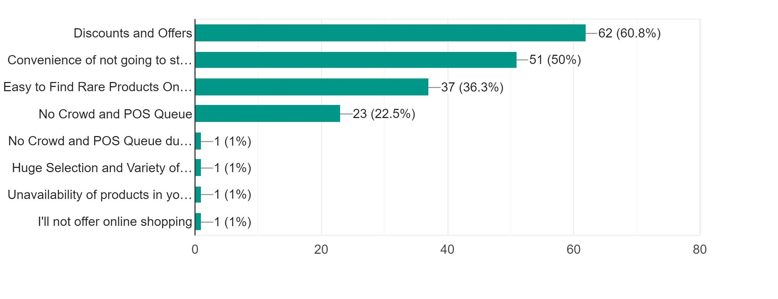
Reason to prefer Online Shopping:

Slide 16
Reason to prefer Online Shopping:
Discounts & Offers: When asked about Discounts and offers, over 60.8% of the respondents said they look for discounts and offers while shopping. This result was as expected as we can say the discounts are the key to their shopping online. The survey also confirms that offers are the most important factor while making any purchase.
Convenience of not going to store: 50% of the respondents listed the convenience to shop as the most important reason to shop online you can do it from anywhere, anytime. It is best, especially for someone who doesn’t have much time to locate or visit a store physically.
Easy to Find Rare Products Online: Over 36.3% responded said they shop online because it is easy to find variety of products in one place.

Slide 17
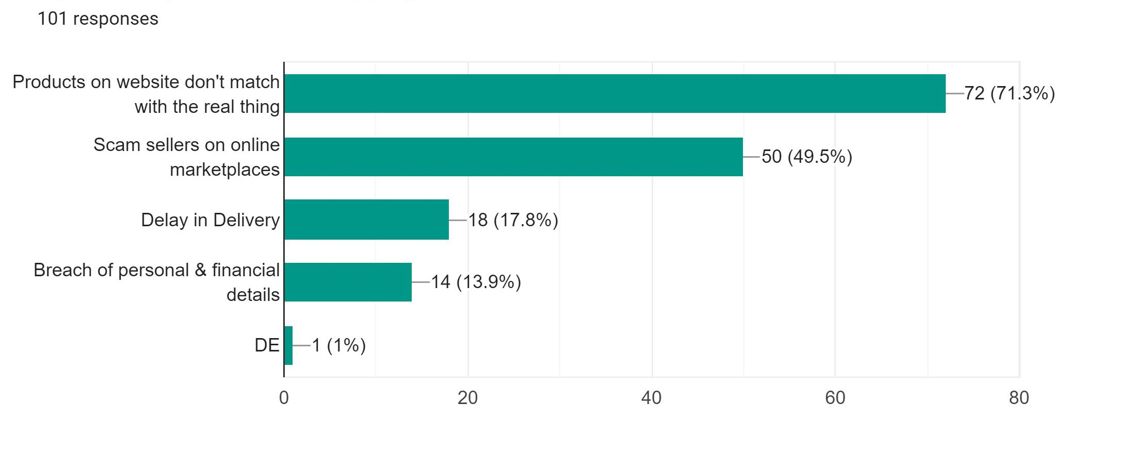
Reason don’t prefer Online Shopping:

Slide 18
Reason don’t prefer Online Shopping:
Products on website don't match with the real thing: Over 71.3% respondent don't trust the quality of the products sells online, since they prefer tell the quality through touching objects and checking them on the spot.
Scam sellers on online marketplaces: 49.5% respondent listed while online shopping there is so many scams and stealing important info from consumers that is the reason Identity Fraud. Many time cloths that is ordered online don't fit so people like trying them on in a store instead.
Delay in Delivery: Over 17.8% respondent claims the delivery of the product to customer’ s doorstep takes about 1-3 weeks. This frustrates the customer and prevents them from shopping online.

Slide 19
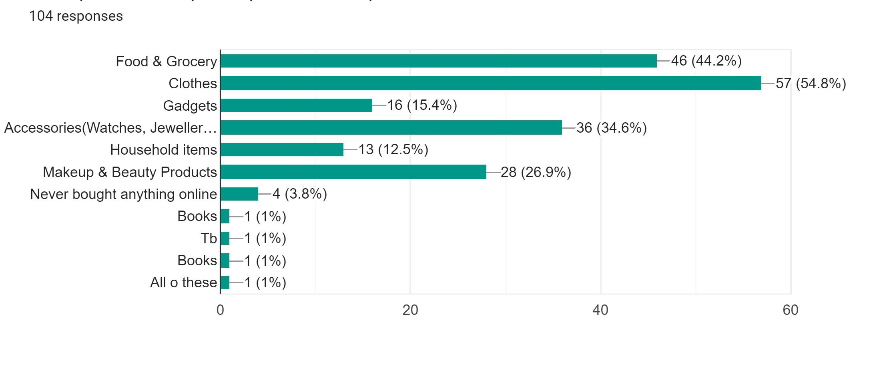
Most preferred product buy Online:
2/3 of the ‘best e-commerce sites’ sell clothing online.That confirms data from an earlier online shopping behavior survey saying that clothing is the most popular product buyers shop for online.

Slide 20
Analysis

Slide 21
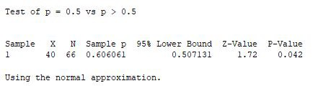
STATISTICAL TESTS:
Do you prefer online shopping ? (1 proportion test)
Results: As P-Value < 0.05, therefore we reject Ho and accept H1. This indicates that more people prefer online shopping.

Slide 22
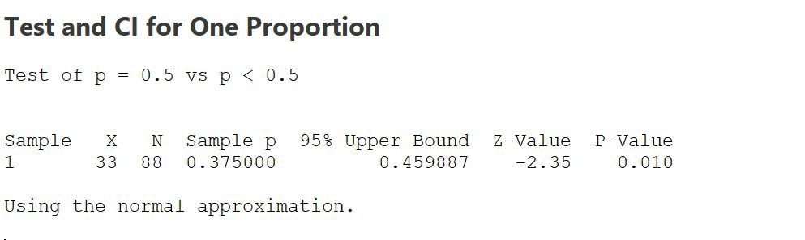
STATISTICAL TESTS:
Do you think you buy unnecessary things and spend more money in online shopping as they are a click away? (1 proportion test)
Results: As P-Value > 0.05, therefore we reject H1 and accept Ho. This indicates that people do not buy unnecessary things and spend more money in online shopping.

Slide 23
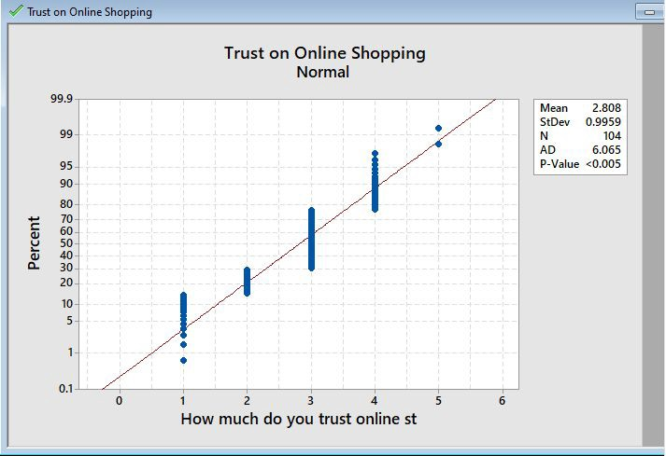
STATISTICAL TESTS:
How much do you trust online stores ?(Normality test)
Results: As P-Value < 0.005 therefore, it indicates that data is not normally distributed.

Slide 24
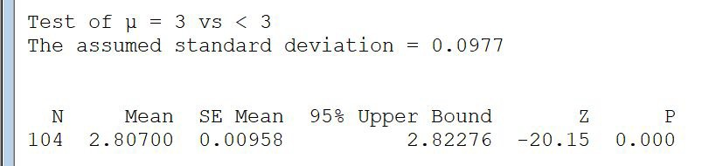
STATISTICAL TESTS:
How much do you trust online stores ? (Mean test)
Results: As P-Value > 0.05, therefore we reject H1 and accept Ho. This indicates that people trust on online stores is average (Neither so good nor so bad).

Slide 25
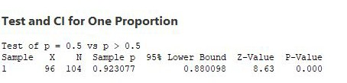
STATISTICAL TESTS:
How often do you shop online ? (Mean test)
Results: As P-Value < 0.05, therefore we reject Ho and accept H1. This indicates that more than 50% of people shop online.

Slide 26
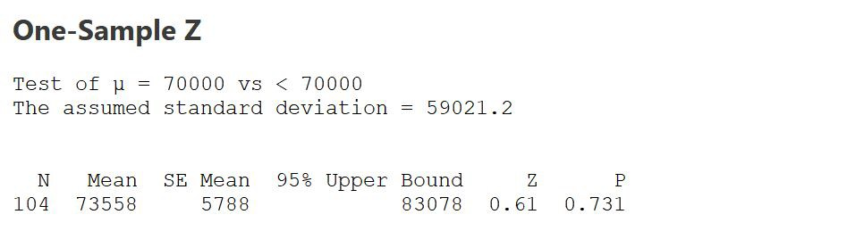
STATISTICAL TESTS:
Monthly Income ? (Mean test)
Result: As P-Value < 0.05, therefore we reject Ho and accept H1. This indicates that mean monthly income of people greater than 50,000.

Slide 27
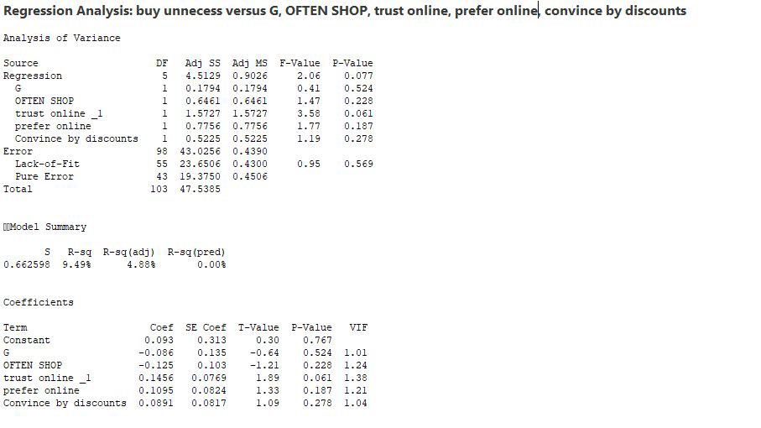
STATISTICAL TESTS:
Regression test

Slide 28
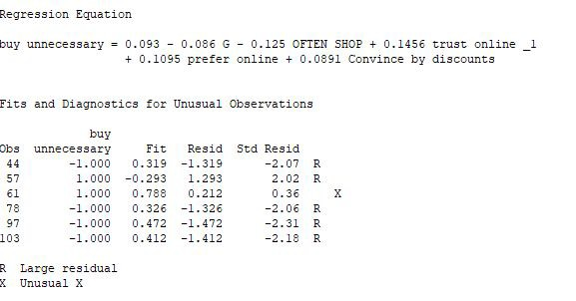
STATISTICAL TESTS:
Regression test

Slide 29
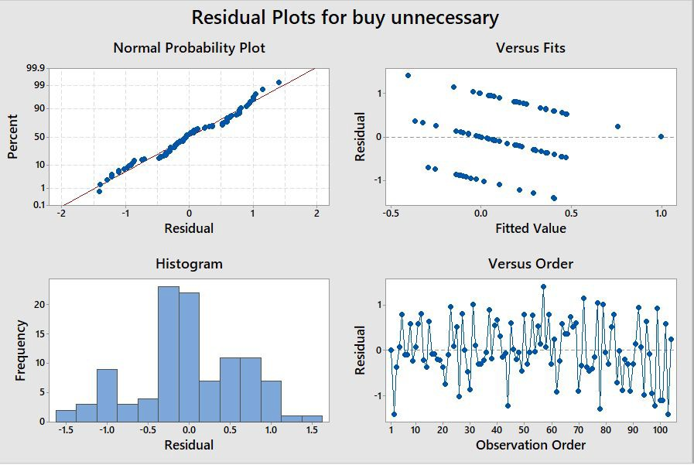
STATISTICAL TESTS:
Regression test

Slide 30
STATISTICAL TESTS:
Regression test

Slide 31
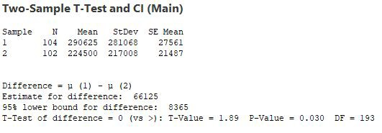
STATISTICAL TESTS:
Two Mean test (physical amount – online amount)
Result: As P-Value < 0.05, therefore we reject Ho and accept H1. This indicates that people spend more money in physical shopping than online.

Slide 32
THANKS!
Any questions?

